Slide 1

Optimal Asset Allocation for
Risk Adjusted Investment portfolios
.
Presented by: Charu Mittal- MA25M008
Ritika Verma – MA25M022

Slide 2

Aim and Motivation
Portfolio optimisation is a fundamental problem in quantitative finance that seeks to construct an investment portfolio balancing the dual objectives of maximising expected return and minimising risk.
In this project, Object-Oriented Programming (OOP) principles are used to design a modular and extensible system, ensuring clarity, scalability, and maintainability. Each financial instrument is represented as an object encapsulating its attributes and behaviour, enabling clean abstraction and reusability across modules.
01
02
03
Modular Architecture
Mathematical Optimisation
Flexible Framework
Data acquisition, portfolio construction, and optimisation implemented as interchangeable components through factory and interface-based architectures.
Models such as mean-variance or covariance shrinkage methods applied to determine optimal capital allocation across assets under practical constraints.
Architecture supports flexible experimentation with different data sources and algorithms, promoting transparent, data-driven asset allocation and risk management.

Slide 3
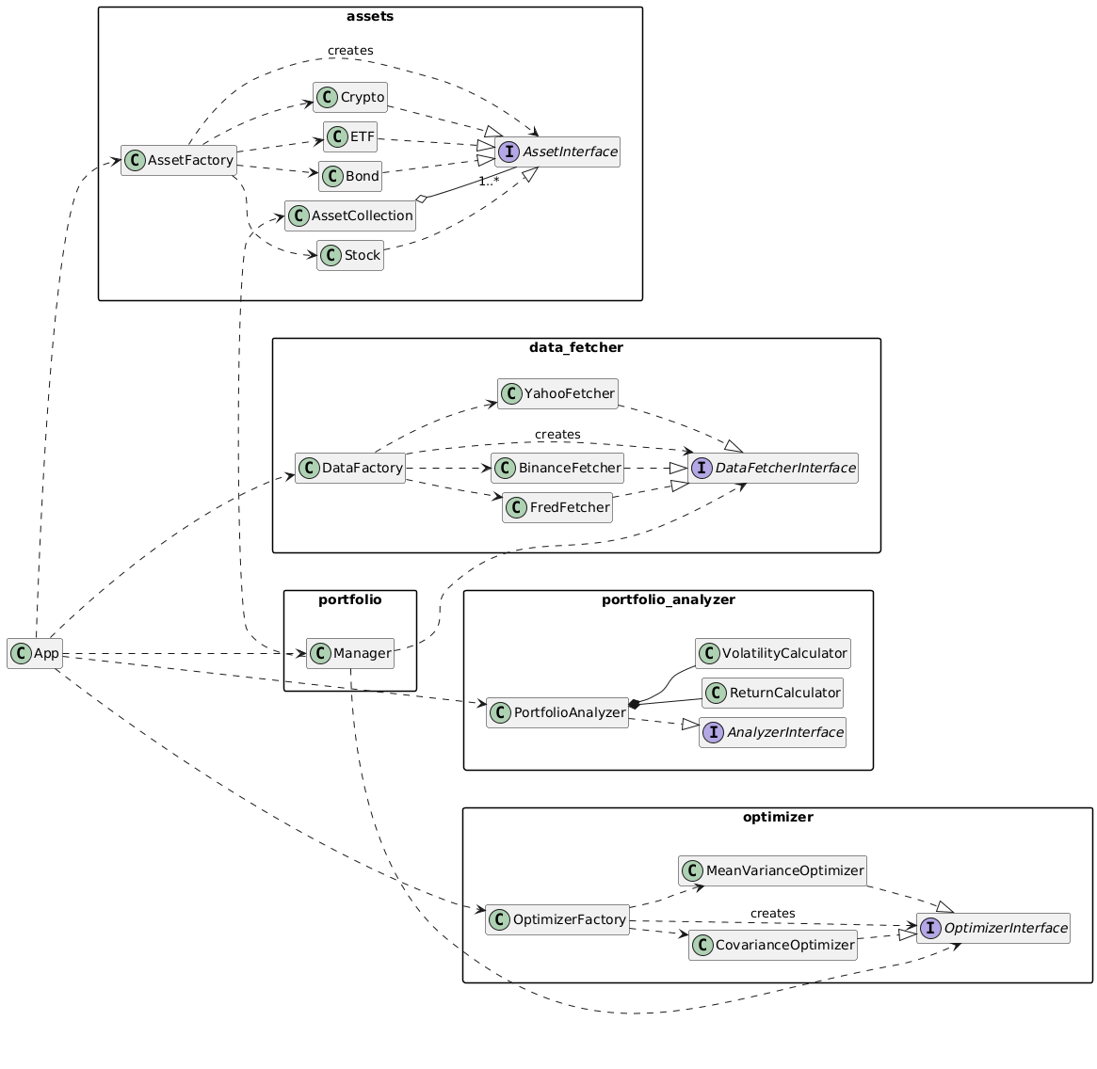
Object-Oriented Principles in Action
Our architecture demonstrates all four core OOPS principles as well as SOLID principles, creating a robust and extensible framework
for financial modelling.
Abstraction
Defined abstract base classes for core functionalities: AssetInterface, DataFetcherInterface, OptimizerInterface, and AnalyzerInterface provide clear contracts.
Encapsulation
Each module hides internal logic behind clear interfaces. Classes like Stock, Crypto, and PortfolioAnalyzer protect their data and expose only necessary methods.
Inheritance
Concrete classes derive from abstract bases. Stock, ETF, Bond, and Crypto all inherit from AssetInterface, promoting code reuse and consistency.
Polymorphism
Common interfaces enable different implementations. DataFetcherFactory returns YahooFetcher, FredFetcher, or BinanceFetcher based on asset type dynamically.

Slide 4
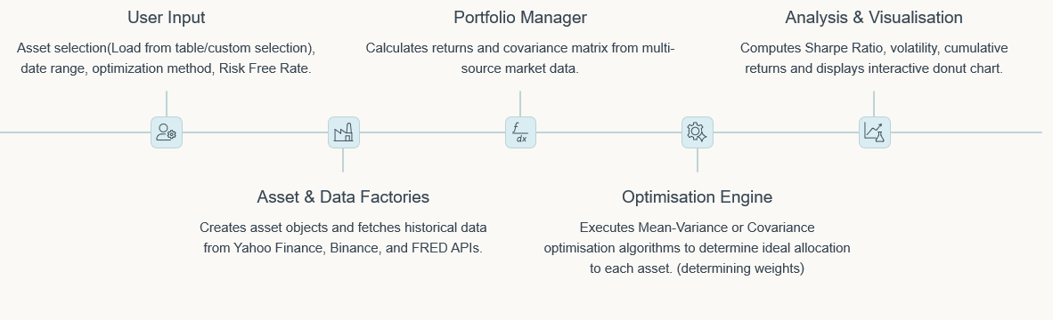
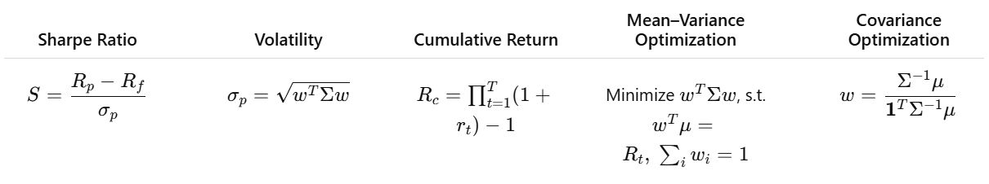
End-to-End Optimisation Workflow
Our pipeline shows how using OOPS concepts makes each part of the system work independently, while the Portfolio Manager brings everything together smoothly from taking user input to
showing the final results.

Slide 5
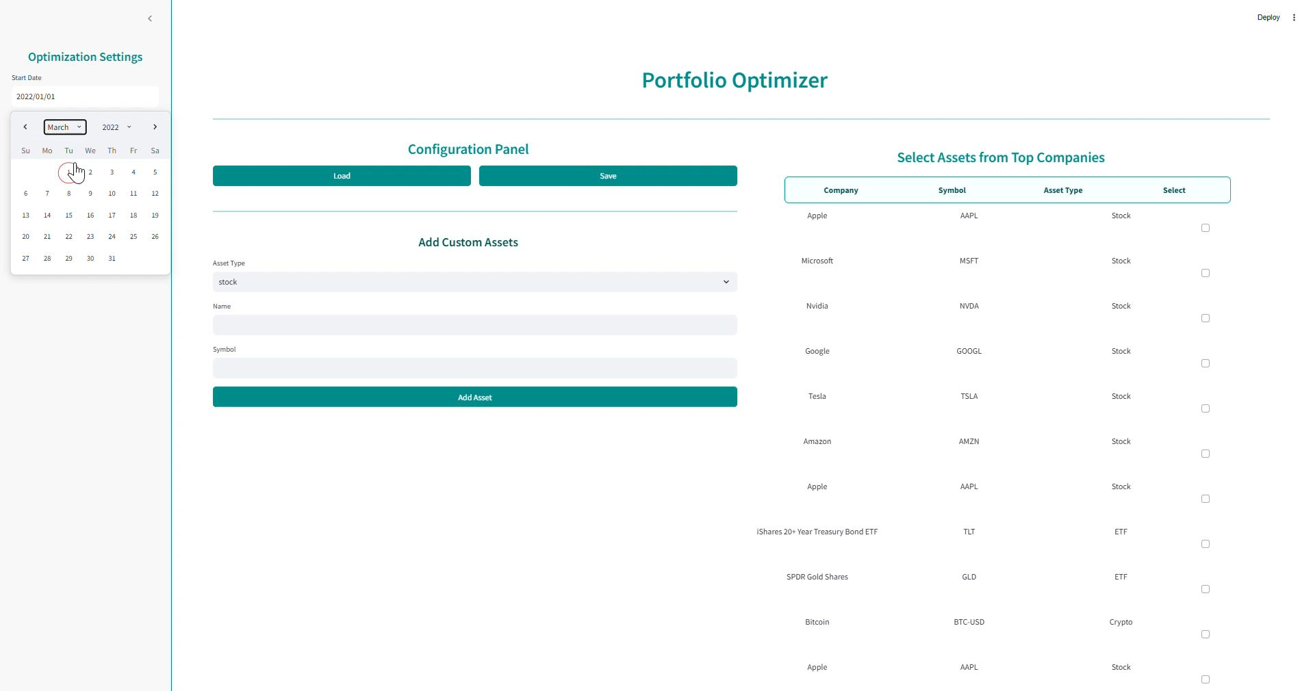
DEMO VIDEO
Real Time Implementation: Portfolio Optimizer

Slide 6
.
Challenges & Future Work
Challenges
Future Work
Managing multiple asset types (stocks, crypto, ETFs, bonds) under a single unified framework.
Incorporate user’s initial investment into the optimization model for personalized allocation.
Maintaining code modularity and extensibility while integrating multiple components (fetching, optimizing, analyzing).
Integrate reinforcement learning-based trading agents for adaptive market decision-making
Handling inconsistent data formats and missing values from different financial APIs (Yahoo, Binance, FRED).
Implement real-time market monitoring and automated alerts for portfolio adjustments.
Dealing with optimization failures due to singular covariance matrices or numerical instability
Deploy on cloud infrastructure for multi-user access and scalability.
Ensuring smooth user interaction and responsiveness in the Streamlit dashboard while processing large datasets
Enhance visual analytics using multi-page, interactive Streamlit dashboards for better transparency

Slide 7
Thank You!

